Slide 1
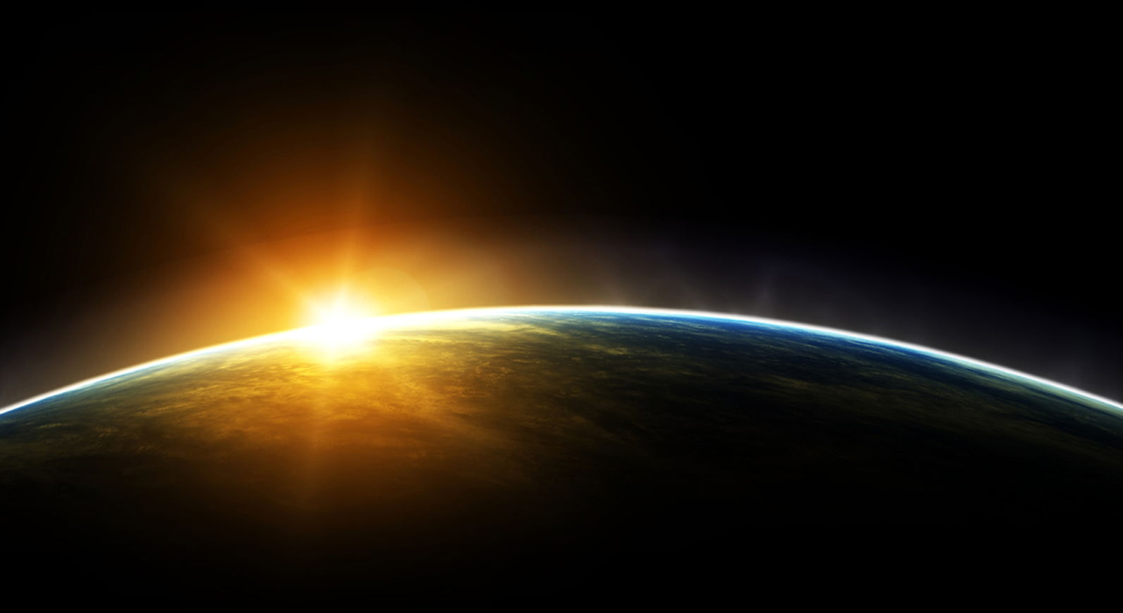
12/3/2013
The Model
www.ontheorigin.com

Slide 2
Introduction
A Quest by Fons Wils

Slide 3
Why the quest?
‘The sense that everything has a soul,
making everything do what it does…’
The soul is the thing
that gives everything purpose.
The soul has lost it’s place in our analytical mindset.
© Fons Wils 2012

Slide 4
rediscovering THE SOUL…
Abandon a compartmentalized view and get into integrated thinking and being
Combine analytical and holistic thinking creating a new paradigm mandatory to change the world…

Slide 5
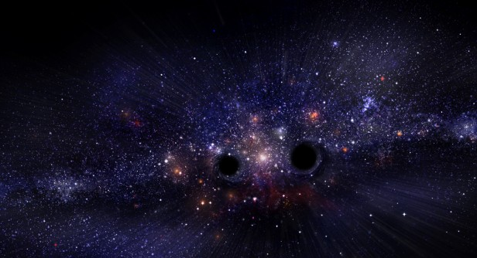
What are we going to do?
We attempt to discover the structure of Matter by…
© Fons Wils 2012

Slide 6
the creation of
a Model revealing the
origin, behavior
and Nature
of Matter

Slide 7
Why…
…is Fons making it so difficult?
A typical question coming from the ‘alternatives’.
They typically live in their own world en don’t bother about credibility… ‘What is it good for?’

Slide 8
Because…
…you have to understand the intentions of your adversary:
Science!
Science has a very dangerous side:
Scientists will either ridicule or completely deny
anything which in their eyes is not proven.
The attacks on the alternatives increase
and they lose terrain…

Slide 9
What is science doing?
“Parapsychology is nonsense” (according to ‘their’ norms)
“Astrology can not possibly be right” (according to ‘their’ vision)
To arrive to such statements, they often use irrelevant arguments!
Evidence based medicine:
Homeopathy: “there are no working substances”
Food supplements cause cancer
Pharmaceuticals are being called medicine (a cure)

Slide 10
The Defense of alternatives: Pseudo-science
There is a whole array of semi-scientific attempts to prove the alternatives right:
‘Tachyons’
A list of ‘prophets’
‘I feel it’…
Pendulums and dowsing rods become scientific instruments…
These arguments only add to the scientists’ defense that this is all nonsense…

Slide 11
What IS reliable TODAY?
What are facts?
Salt, Fever,…
Example: Genetics vs. Epigenetics
How often does ‘scientific proof’
turns out to be false?

Slide 12
That’s why…
…we started the quest to find a Model
which would do better…
not only then the ‘alternatives’
but also then the ‘scientists’…

Slide 13
ANALYSIS OF CURRENT STATE OF AFFAIRS…

Slide 14
How do we start with it?
What do we ‘know’?
Or… what is ‘knowing’?
One can bring such a lecture in several ways…
We could start just like any physicist would do…
By overwhelming your audience with your knowledge…
Let’s do that first…
And please interrupt me when it is ‘enough’…

Slide 15
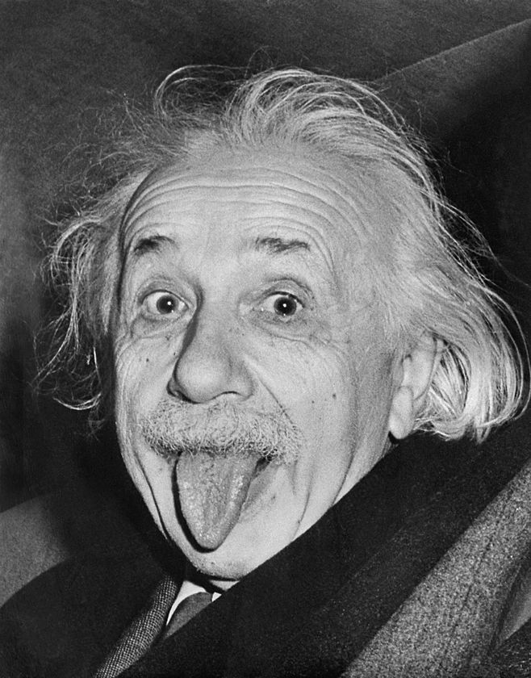
Some laws of physics
We discovered 3 energy equations:
Light (photons): E = h.ν
(h = Planck’s constant, ν = frequency)
Electrons: E = p.c
(p = impulse, c = speed of light)
Nucleus matter: E = m.c²
(m = mass)
Light can behave as wave (interference) or as a particle: a choice that light makes depending on the situation

Slide 16
Understanding Quantum mechanics
Matter behaves according to the uncertainty principles:
ΔE. Δt ≥ ℏ (E = energy, t = time, ℏ = h/2π)
Δp. Δx ≥ ℏ (p = impulse, x = space)
The behavior of elementary matter can only be described by laws derived from chance. This is what is described in quantum mechanics: the equations of Schrödinger and Dirac.
Weird note: elementary particles are points without any size
and they can be entangled.

Slide 17
Conservation & constants
Conservation laws: energy, momentum, angular momentum, ...
Constants: the speed of light (c), the elementary charge (e), the mass of an electron (me), the mass of a proton (m_{p}), Avogadro's number (NA), the Planck constant (h), the universal gravity (G), the fine structure constant (α) and the Boltzmann constant (k).
Weirdest constants are interaction constants. They are determined by statistical calculations: the so-called path integrals. They seem to describe the history of interaction.

Slide 18
CHAOS
The chaos of the entire Universe increases irreversibly (entropy)
Fractal theories
Prigogine: dissipative structures or unexpected order in chaos

Slide 19
INGREDIENTS
The Laws of Physics contain ingredients:
the dimensions of Space and Time that shape the Universe.
elementary particles which contain energy and which compose Radiant Matter (photons, electrons, quarks, ... = 4%).
Moreover, there are the Forces that organize matter:
Gravity
Electromagnetism, the Weak Interaction
and the Strong Interaction.
We also have Dark Matter (neutrinos, ... = 21%)
and Dark Energy (= 75%).
These ingredients are necessary to
describe our Laws of Physics

Slide 20
WE PUT ENOUGH EFFORT into this TO FIND THE CONNECTIONS!
Relativity shows a connection between Space and Time by which Gravity can be better understood. The relationship of other Forces with Space and Time remains elusive.
Quantum theory shows us additional but very mysterious rules of Matter in Space and Time.
Field and Gauge theories mapped the Forces and lead us to the experimental Standard Model.
The String Theory and Super symmetry …

Slide 21
Astronomy a la ‘Stijn Meuris’, cosmology a la Hawking!
“Universe came into existence by coincidence. See what we all know about the Universe.”
“Universe is part of a Multiverse…”
You can only ignore the fact that we do not know everything, by believing that we will solve it with our present knowledge:
The antimatter disappeared
Accelerated expanding by Dark Energy
Gamma-ray bursts, Quasars
Rotation of Galaxies requires existence of Dark Matter

Slide 22
One can start asking questions!
What is ENERGY?
How to turn them into MATTER?
…
The rest is for Religion and Philosophy!

Slide 23
And then we ask: what do we ‘know’?
1) One can now give this lecture in a different way, and go back to the previous slides and discuss them in a more profound way. One can clarify the doubts. That's what we do first.
and
2) You might consider it to be impossible, but you will see that there is a lot being suppressed: there are experiments and observations that tell a different story, even in Physics.

Slide 24
‘Knowing’ the laws of physics
We don’t understand the 3 energy equations:
Light (photons): E = h.ν
(h = Planck’s constant, ν = frequency)
Electrons: E = p.c
(p = impulse, c = speed of light)
Nucleus matter: E = m.c²
(m = mass)
We don’t know why light can behave as wave (interference) or as a particle

Slide 25
‘Understanding’ Quantum mechanics
Matter obeys the uncertainty principles:
ΔE. Δt ≥ ℏ (E = energy, t = time, ℏ = h/2π)
Δp. Δx ≥ ℏ (p = impulse, x = space)
The behavior of elementary Matter can only be described by laws of chance. This is what is described in quantum mechanics: the equations of Schrödinger and Dirac.
Weird note: elementary particles are points without any size and they can be entangled.

Slide 26
Conservation & constants
Conservation laws: energy, momentum, angular momentum, ...
Constants: the speed of light (c), the elementary charge (e), the mass of an electron (me), the mass of a proton (m_{p}), Avogadro's number (NA), the Planck constant (h), the universal gravity (G), the fine structure constant (α) and the Boltzmann constant (k).
Weirdest constants are interaction constants. They are determined by statistical calculations: the so-called path integrals. They seem to describe the history of interaction.

Slide 27
CHAOS
The chaos of the entire Universe increases irreversibly (entropy)
In isolated parts of the Universe entropy seems to be decreasing
(living beings)
Prigogine: dissipative structures or unexpected order in chaos

Slide 28
INGREDIENTS
The Laws of Physics contain ingredients:
the dimensions of Space and Time that shape the Universe are not well defined
elementary particles which contain energy and which compose the Radiant Matter (photons, electrons, quarks, ... = 4%).
Moreover, there are the Forces that organize matter:
Gravity (we have 3 versions of what it is)
We can’t find the gravitons
Electromagnetism, the Weak Interaction
and the Strong Interaction from which we ignore
some properties (becomes stronger in a distance)
We also have oscillating and mysterious neutrinos
that deny the Law of Conservation of Energy.
These ingredients are necessary to
understand the Laws of Physics

Slide 29
WE don’t PUT ENOUGH EFFORT into this TO FIND THE CONNECTIONS!
Relativity shows a connection between Space and Time by which gravity can be better understood. It stays in contrast with
Quantum theory seems t deal with Matter in an other kind of Space and Time.
Field and Gauge theories mapped the Forces and lead us to the experimental Standard Model. The Higgs Boson is forced into the world.
The String Theory and Super symmetry did not lead us to deeper insights for 35 years and also not to experimental solutions …
We don’t know what mass is

Slide 30
Astronomy a la ‘Stijn Meuris’, cosmology a la Hawking!
“Universe came into existence by coincidence. See what we all know about the Universe.”
“Universe form inside a Multiverse…”
We do not only not know everything, we also ignore facts:
Accuracy 1/10⁵⁰ makes it a miracle to exist
Did the 50% antimatter really exist?
Dark Energy is a hypothesis without proof
Horizon problem is unsolvable
Gamma-ray bursts, quasars can not be explained by present Physics
Invisibility of Dark Matter

Slide 31
One can start asking questions!
What is ENERGY?
How to turn them into MATTER?
How are the properties of Matter created?
The behavior of Matter determined by Space and Time?
What role does INFORMATION have and how is it kept?
What is COHERENCE and how did LIFE arise?
Is the cause CHANCE or is there a GOD?

Slide 32
And then we have a lot of reasons to ask: what do we ‘know’?
After all this,
we continue with other things
that are not understood!

Slide 33
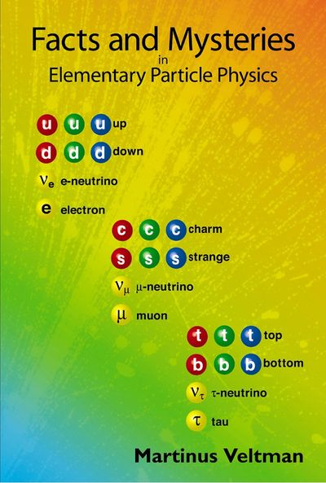
The ‘normal’ quarks
The neutrino and the electron

Slide 34
First generation:
up +2/3e
u
u
u
2 MeV
down
-1/3e
d
d
d
5 MeV
0
νe
e-neutrino
< 2,2 eV
- 1
electron
0,511 MeV
e

Slide 35
Second generation:
charm +2/3e
c
c
c
1,25 GeV
strange
-1/3e
s
s
s
95 MeV
0
νμ
μ-neutrino
< 170 keV
- 1
muon
106 MeV
μ

Slide 36
Third generation:
top +2/3e
t
t
t
171 GeV
bottom
-1/3e
b
b
b
4,2 GeV
0
ντ
τ-neutrino
< 15,5 MeV
- 1
tauon
1,78 GeV
τ

Slide 37
Even stranger:
the 99% missing mass of a nucleon is provided
by Strong Interaction:
neutron
u
d
d
939,57 MeV
= 12 MeV
= 9 MeV
2 MeV
+ 5 MeV
+ 2 MeV
+ 5 MeV
proton
u
d
u
938,27 MeV

Slide 38
Most strange: Weak Interaction
u
d
d
939,57 MeV
neutron
u
d
u
938,27 MeV
proton
80,3 GeV
= 85 times heavier than a neutron
+
intermediate
vector boson
W¯

Slide 39
Transformation of W¯ into lighter particles:
u
d
d
939,57 MeV
neutron
u
d
u
938,27 MeV
proton
νe
e-neutrino
< 2,2 eV
W¯
0,511 MeV
together 143.000 times
lighter than W¯
electron
e¯

Slide 40
Preliminary conclusions of the physicists:
To us space-time and the laws of quantum mechanics are like a decor, the setting of a play. The elementary particles are the actors and Physics is what they do. A door that we see on the stage is not a door until we see an actor going through it. Else it might be fake, just painted on.
You cannot explain the existence of certain particles much as you cannot explain the existence of this Universe.
Source: Martin Veltman, Facts and Mysteries in Elementary Particle Physics 2004

Slide 41
Titles When someone uses titles, be aware where they stand for, they really do not increase his credibility!
The one who it concerns: only the content of what he/she says is important
prof. Dr. Ir. Somebody
Brainwashed
Paid by the system
Eye patch sufficiently large

Slide 42
Very much
The average person fits in here
Ir
Master
After all his studying he/she belongs here
Dr
Number of subjects someone knows something about
Line of progression
Professor Dr Ir
State of mind
Very much
NOTHING
Amount of knowledge about a subject

Slide 43
THERE IS NOTHING MORE DANGEROUS THAN A CLOSED MIND…

Slide 44
SCIENCE
?
PHYSICS
Origin
Single event ≠ coincidence
Holistic thinking
The measurable
The repeatable
Analytical thinking
versus
Laws of Physics
Origin of coherence
= pure speculation
Prigogine
Dissipative structures

Slide 45
CHEMISTRY
Measurable
Matter has no memory
Makes no distinction between natural and synthetic molecules.
Medicine
Quackery?
Homeostasis
Symptom management
Natural products
Homeopathy, Acupuncture
Alternative Treatments
Patented synthetic substances
Hard provable effects
Individually, not 100% for everyone = nonsense
100 % proven effects

Slide 46
Biology
DNA by chance
Panspermia
Creationism
Creation stories
Cosmology
Religion
Biblical stories
Mithras
Archeology
Crucifixion
Multiverse
Chance
Abuse of power
Theological nonsense
Big Bang with huge gaps
Wars

Slide 47
Philosophy
?
Rational thinking
Assumptions
Reductionism
Atheism
Spiritual
Mysticism
Masonry
versus
Quantum jumps
Tachyons

Slide 48
Conclusions
GOD
no connection
incommensurable
Laws of Physics
Laws of Consciousness

Slide 49
Despite the feeling that something is wrong, THE scientific Credo continues
If you can not measure it, it does not exist!
This credo can only maintain thanks to:
black & white - thinking
analytical thinking
the box thinking
Thus, no ‘why’ question is being answered!

Slide 50
CONCLUSION
You could say that Science has a very dangerous side:
Its practitioners are planning to ridicule everything or even declare non-existent which in their eyes is unproven.
But it's worse than that:
Scientific thinking has contaminated our entire thinking.
There is no longer a quest for the truth!

Slide 51
At each INSTANCE, we are forced to THINK 'analytical'
We should not have any suspect that there might play something else.
For example, no account of possible missing parameters that shows that reality is not the same as 'the truth'.
Another truth
A truth
Yet another truth
Reality

Slide 52
In many other disciplines, a lack of SEARCH FOR truth emerges
Medicine: evidence-based medicine, no longer listen to the patient
Psychology: they do not understand the human mind
Justice: people without any form of evidence convicted or prosecuted

Slide 53
CONSEQUENCE:
Everything is manipulated
to greater glory
of all those who have power.
The only thing you can do about it is to normalize again our way of thinking!

Slide 54
What is science today?
Scientific details blind us. Science suffers from an acute lack of depth.
Science fails to penetrate into the inside, what makes Nature do what she does...
Physics fails to discover the origin of the Laws of Physics.
Cosmology does not know where the Universe came from.
Box thinking reigns. No understanding of cohesion or what started the Universe, created Life and makes it do what it does.
All facets of life are ‘scientified’ and thus violated.
Medical science is being abused with only one goal: making the shares of the pharmaceutical giants healthy.
So-called ‘scientific evidence’ can be regarded as collecting arguments with just one goal: to create something that can generate money. This is the reason behind the pressure for scientific publication… The money has to keep on rolling…

Slide 55
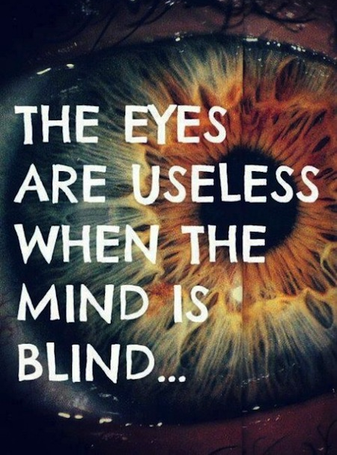

Slide 57
I think so I am? This statement by Descartes is not the truth.
{
see, hear, smell, taste, touch, sense
I think I
depict reality imagine reality
I am = part of BEING

Slide 58
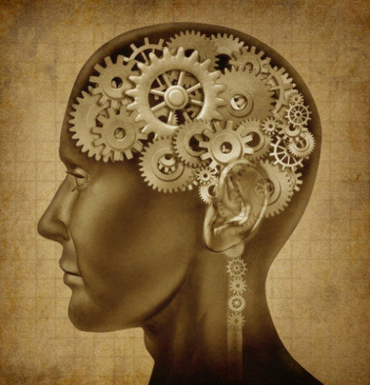
Analytical = FOCUSED ON DETAIL
Make analytical derivations
The physical examinations
Study the behavior
Intellectualizing
Believe in coincidence
⇒ Box Thinking

Slide 59
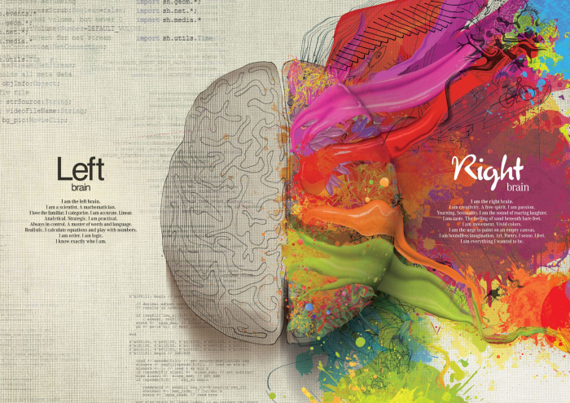
Holistic = Focused ON THE WHOLE
Mental pursuit of coherence
Rapport
Understand the nature of things
Feeling for authenticity
The search for the ‘core’
⇒ Floating

Slide 60
WHY Haven't the holistic thinkers not won terrain?
They did not find yet
the right axioms!

Slide 61
Ordering Details versus Global oriented
Analytic = making deductions
Holistic =
searching coherence
Material
Connectivity
Behavior
Nature
Intellectualism
Sense
Coincidence
Soul

Slide 62
The dualism between analytic (A = ordering details) and holistic (H = big picture) should be lifted:
A&H = H&A =
General overview & ordening Details
= GooD = G∞D

Slide 63
What’s going wrong? DID WE ASK OURSELVES THE WRONG QUESTIONS?
Ever since Newton mathematics rules Physics.
This is resulting in the fact that we are only observing the outside, the behavior of Matter/Nature.
We do not understand:
What is driving the Energy/Forces
What makes Matter come together en makes it grow to complex organisms, the inside…

Slide 64
“Discovery consists in seeing what everyone else has seen and thinking what No one else has thought.”
Albert Szent-Gyorgyi

Slide 65
After 30 years of puzzling only this possibility remained
Minkowski described in 1908 the relationship between space and time in a mathematical formula:
s² = x² + y² + z² - c²t²
Minkowski made a wrong choice by turning time in a real dimension instead of an imaginary!

Slide 66
Permanent magnet
What is delivering the energy for a permanent magnet to stick to a metal plate?
Metal plate
Permanent magnet

Slide 67
A Fairytale: Once upon a time there where 6 core dimensions…
Together they formed an acausal POTENCY.
Acausal means
no cause and no effect.
Usually means acausal
that course of time is not a playing factor.

Slide 68
INDEED, these 6 core dimensions were…
…together so powerful that they did not allow
their sub dimensions or their constituent points:
to have a course of time: they lived in Simultaneity
and
to be
separated by Space: they possessed Non-Locality

Slide 69
From the HERE and NOW these properties are almost unrecognizable!
What else is Simultaneity:
To be independent from cause and effect,
to not know a course of time, or always be present.
What else is Non-Locality:
To be independent from a position in Space
or to be everywhere.

Slide 70
Then one of those Super Dimensions became rebellious and uncorded!
The consequences were immense:
The Simultaneity ceased to exist.
The other Super Dimensions were now only Non-Local.
The Super Dimension which uncorded split into three parts:
Two opposing volatile dimensions and one rigid.

Slide 71
What are volatile and rigid dimensions?
A volatile dimension is like the arrow of time:
It irreversibly spurts forth in a certain direction. It is a course, a kind of drive.
A rigid dimension is like the dimensions of space:
you can return to the same point, it is reversible.
Mathematically you can represent:
A volatile dimension as imaginary,
A rigid dimension as real.

Slide 72
Then also the other Super Dimensions uncorded
Their volatile dimensions became courses of space.
Three of their rigid spatial dimensions become the dimensions that we think we know in our Universe.

Slide 73
Matter is composed by volatile dimensions: the Course of time and one or more courses of space
Quark
+t’
x
-x’
-z’
-e’
A red pre-phase up-quark

Slide 74
Matter (62,5%) versus potency (37,5%)
Universe Coherence
NOW versus SIMULTANEITY
HERE versus NON-LOCALITY

Slide 75
There are so many more possibilities in physics…
But it is a threat for the existing world order...
Clean energy, less consumption…
Transmutations…
Cold fusion
More…

Slide 76
LIGHT
Wave : Information is spread across space
(non-locality) into the NOW
Particle: Information is also outside the NOW
Information of data
Feedback
Feedforward = Drive
Past
NOW
Future
Course of time

Slide 77
THE MEASUREMENT OF THE HEART, BRAIN, BODY…
Influence before unidentified images:
The heart is raving ahead: it shows Feedforward, it knows what will come.
The brain is following the NOW.
The body lags behind: it shows Feedback.
Brain
Body
Heart
Past
Future
Nu
Before
Afterwards

Slide 78
Feedback versus Feedforward
Feedback: accumulation of information
Feedforward: take everything with you
Split between the 2 is the NOW: reality
The NOW grows by adding up the immediately preceding and the immediately following…
growthprocess
NOW
FF
FB
Past
NOW
= Driven growth
Future
Course of time

Slide 79
A natural growth process follows a certain ratio, driven by SIMULTANEITY,
Supplemented with non-locality this causes of the appearance of LIFE
NOW 1/1
NOW 5/3
NOW 21/13
NOW 55/34
0 – 1 – 1 – 2 – 3 – 5 – 8 – 13 – 21 – 34 – 55 …
NOW 2/1
NOW 8/5
NOW 34/21
NOW

Slide 80
The Fibonacci Series
2 : 1 = 2
3 : 2 = 1,5
5 : 3 = 1.66
8 : 5 = 1,6
13 : 8 = 1,625
21 : 13= 1,615
34 : 21 = 1,619
55 : 34 = 1,618
1,618
Φ φ
phi
Pythagoras:
Golden Ratio or Divine Proportion
⇒ geometric dynamic proportion

Slide 81
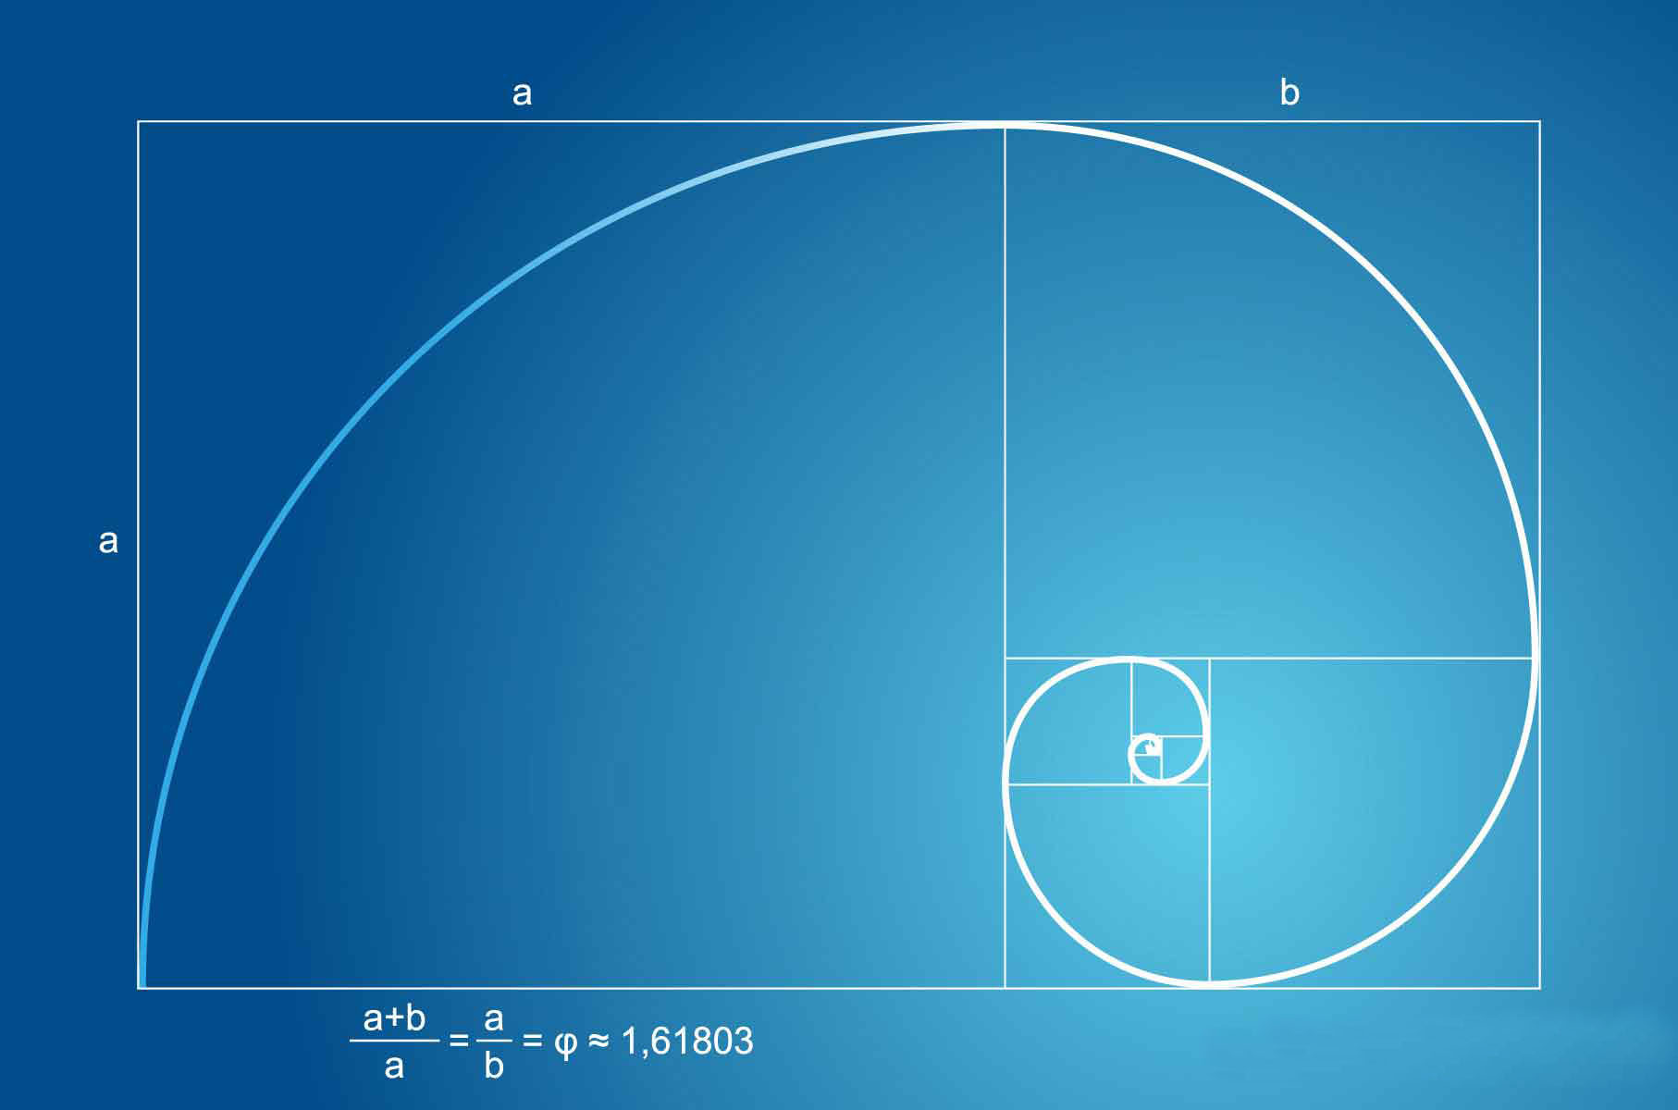

Slide 82
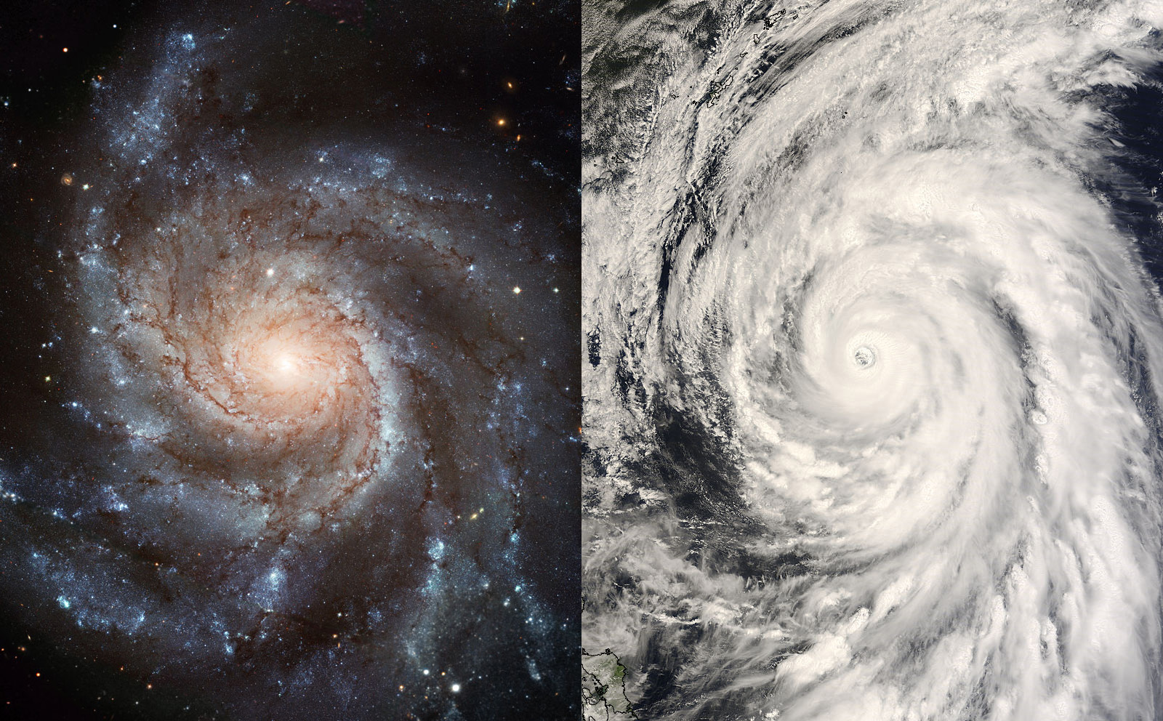

Slide 83
SCIENCE & TECHNOLOGY
PHYSICS
Origin of Matter and of the Universe.
Deterministic Quantum
Also the not-measurable and the single event!
Additional Laws of Physics
The discovery of the Laws of Coherence
Immediate communication,
new technologies such as Cold Fusion!

Slide 84
Example of the MYSTERIOUS ENERGY FROM HYDROGEN!
Black Light Radiation
Randell Mills

Slide 85
TU DelFT, 23 nov 2006
In his research lab at TU Eindhoven physicist Professor Gerrit Kroesen generated a plasma in a vacuum tube surrounded with cords and equipment. The bright blue glow that was shimmering through the window of the experiment was hurting his eyes. Kroesen looks like a novice magician who has just performed a successful trick. He knows very well that what is happening in the vacuum tube is in fact impossible...

Slide 86
What happens?
The recipe is simple: a tungsten filament, put in a cylinder of hydrogen, very low pressure of 0,01 atmospheres, and some grains of strontium . Heating the coil below 70 volts, and wait until the tungsten glows at a temperature of over one thousand degrees Celsius .
The strontium will evaporate and the molecular hydrogen (H2) will be split into separate H - atoms by collisions with the hot coil. Suddenly a plasma emerges of 400 hundred thousand degrees C. The spectrum of the light emerging suggest the temperature of the hydrogen goes up to.
A high-energy ultraviolet light free emerges with a wavelength of 10 to 150 nanometers, which should be impossible. A plasma normally occurs only at much higher temperatures, or a much higher electrical voltage than 70 volts. Also the extreme ultraviolet should not be there. Moreover, the extreme ultraviolet light contains quite peculiar light frequencies. Is that the gleam of something else? Perhaps the fingerprint of shrunken hydrogen?

Slide 87
CHEMISTRY
Distinction between smart natural en stupid synthetic molecules
The measurable
Matter has memory
Acute
Medicine
Homeostasis
&
Natural products
Homeopathy, Acupuncture
Alternative treatments
Bach flower essences,…
Medicine of
chronic illness
Provable effects
Individual, not 100% for everyone…!

Slide 88
How a substance is recognized?
We humans: lab, name, know how, manuals…
Organisms: Immaterial label, containing a certain ratio that relates to way it comes into existence.
SIMULTANEITY is that what relates to the history of things.
NON-LOCALITY relates to the recipient, the environment.

Slide 89
Biology
DNA emerges because of steering mechanism
Creationism
Creation stories
No Multiverse
No book religions
No Coincidence
Seeking the TRUTH in BEING
Buddhism
Tantra, yoga
Meditation
No Big Bang
Cosmobolism

Slide 90
PHILOSOPHY
Rational thinking and
Reductionism
Spiritual
Mysticism
Gnosticism
&
Psychology
Steer behavior Stimulate creativity
Pre-history Subconscious
Genetics Archetypes
Astrology en Reincarnation?

Slide 91
Conclusions
BEING
many
relations
Laws of PHYSICS
Laws of CONCIOUSNESS

Slide 92
A FINAL WORDGAME
AVOIR (=to have) Is to have and that
IMPOSER (=to rule) has ruling as a consequence
MOURIR (=to die) but everything is temporary.
ETRE (=to be) If you are
RESTER (=to stay) than you will stay!
The best way is to combine TO HAVE and TO BE by using the first letter of each word:
AIMER is to love!

Slide 93
THAT’S IT FOR NOW…

